Slide 1
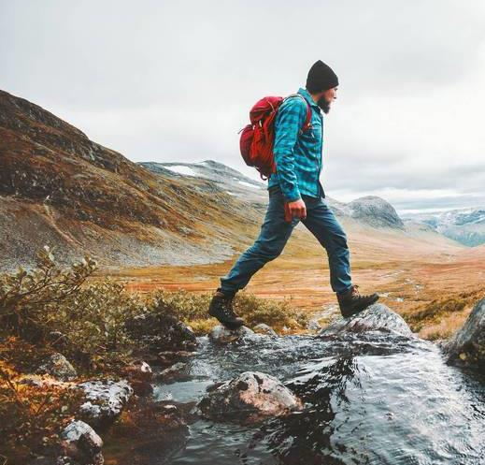
Outland Adventures
Taylor Nairn, Benjamin Andrew, Joshua Rex
Database Development and Use, 7/10/2023

Slide 2


The Case Study
Blythe Timmerson and Jim Ford, both outdoor enthusiasts, opened Outland Adventures as a sideline to their fulltime careers. They hoped to cater to other people who enjoyed hiking and camping in far off places. They thought that if they could arrange guided trips, provide the equipment needed, and develop the right advertising, then Outland Adventures might just succeed. When it became apparent that they had identified a much needed market, they both quit their current jobs and devoted their full time and energies into their joint venture.

Slide 3
The Case Study
When they started running Outland Adventures, they hired two guides; John ‘Mac’ MacNell, and D.B. ‘Duke’ Marland. These two would be in charge of organizing and planning the trips, including investigating airfares, visa requirements, and inoculations.. Blythe and Jim also hired Anita Gallegos to take over the marketing aspect of the organization. Dimitrios Stravopolous is responsible for ordering supplies for the trips as well as keeping the equipment inventory up to date.

Slide 4
The Case Study
Customers may either rent or buy their equipment outright. Mei Wong has just been hired to develop an ecommerce site where potential customers can find out information about Outland Adventures, check on trip schedules, and purchase hiking and camping equipment.

Slide 5

The Problems
So far, they have conducted treks in Africa, Asia, and Southern Europe. Is there any one of those locations that has a downward trend in bookings?
Are there inventory items that are over five years old?
Do enough customers buy enough equipment to keep equipment sales?

Slide 6
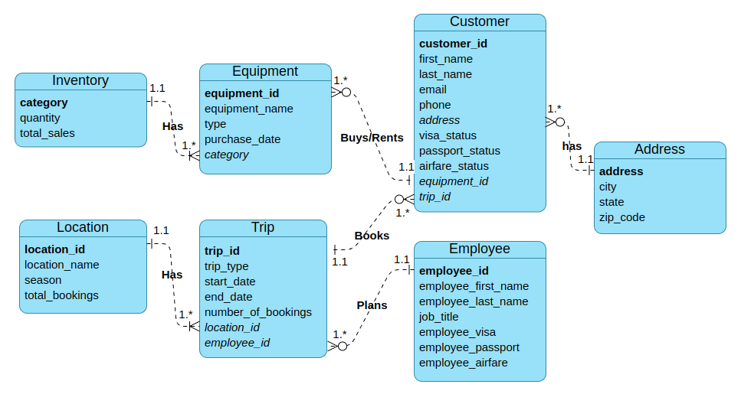
The Design of the Database

Slide 7

Report #1
Step 1: Organize each trip by location name and start date.
Step 2: Print out the number of reservations for that trip.
Step 3: Calculate whether there was an increase or decrease in bookings for that trip.
Step 4: Display the difference in reservations as a percentage.

Slide 8
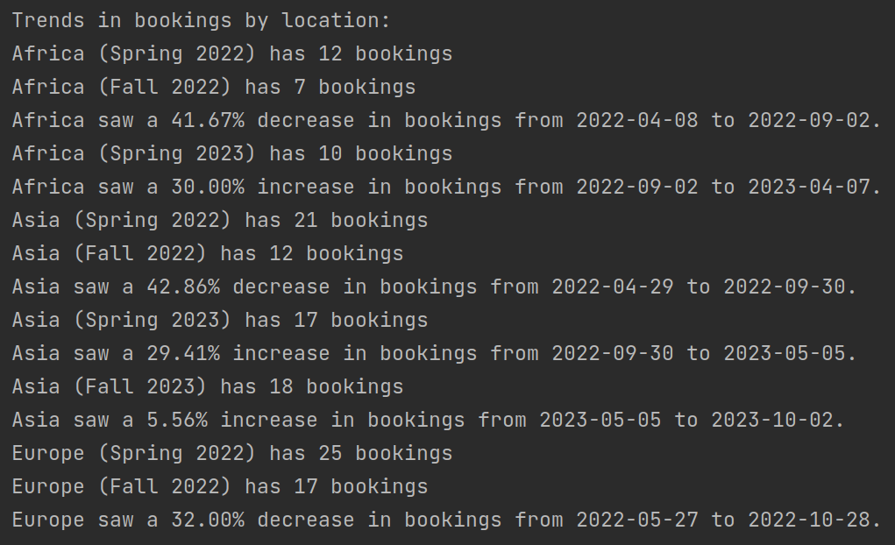

Report #1 Output:

Slide 9
Report #2
Step 1: Gather all pieces of equipment and their respective purchase dates into a single table.
Step 2: Check if any items were purchased five or more years ago.
Step 3: Display any items in the database that meet both of those conditions.

Slide 10
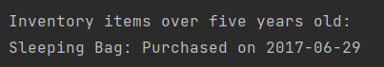
Report #2 Output:

Slide 11
Report #3
Step 1: Use the aggregate function "COUNT" on all equipment purchases contained in the customer table.
Step 2: Display the result.

Slide 12

Report #3 Output:

Slide 13

Assumptions made in the Design:
Each customer has a unique CustomerID.
Each trip has a unique TripID.
Each equipment item has a unique EquipmentID.
Each employee has a unique EmployeeID.
Each inventory item has a unique Category.
The age of an equipment item can be calculated based on the purchase date.

Slide 14
Assumptions made in the Design:
Equipment is specified for rent or sale.
If used equipment is sold it is first declassified as rental inventory.
There can be multiple customers participating in a trip.
There can be multiple trips organized by a guide.
An employee can have only one job title at a time.

